Slide 1


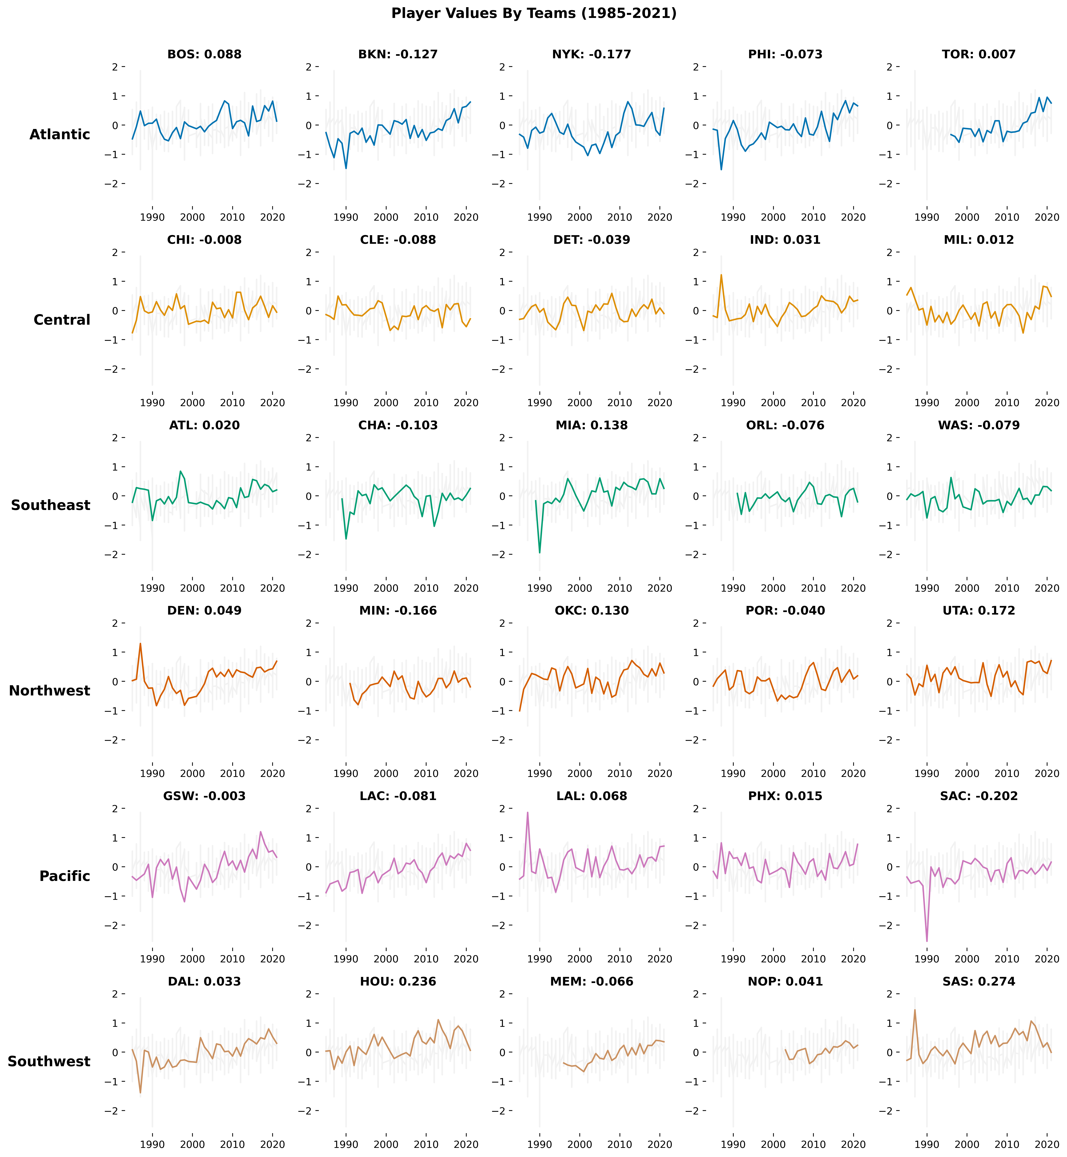
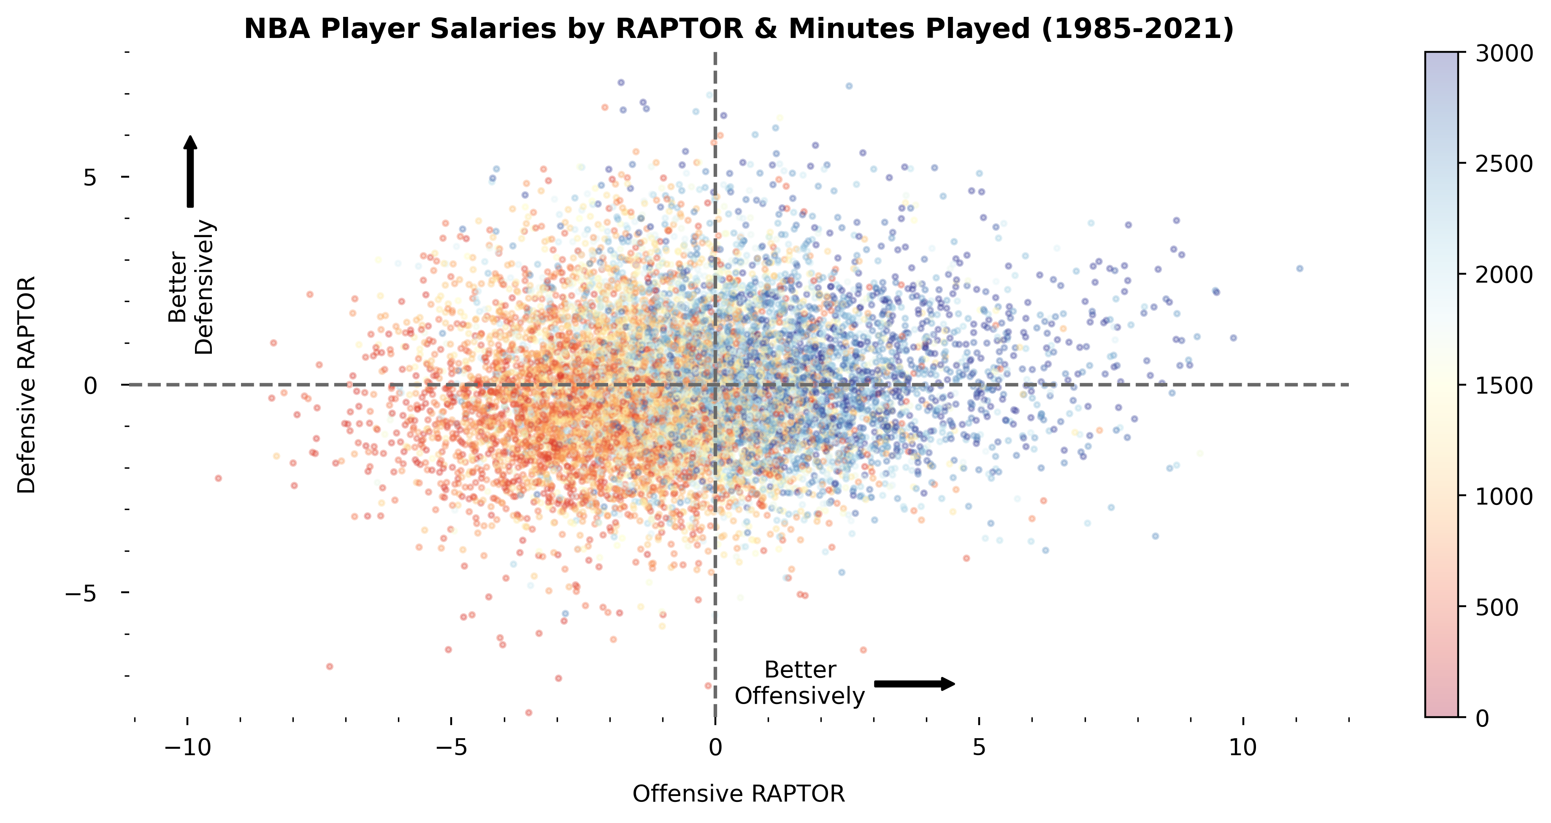
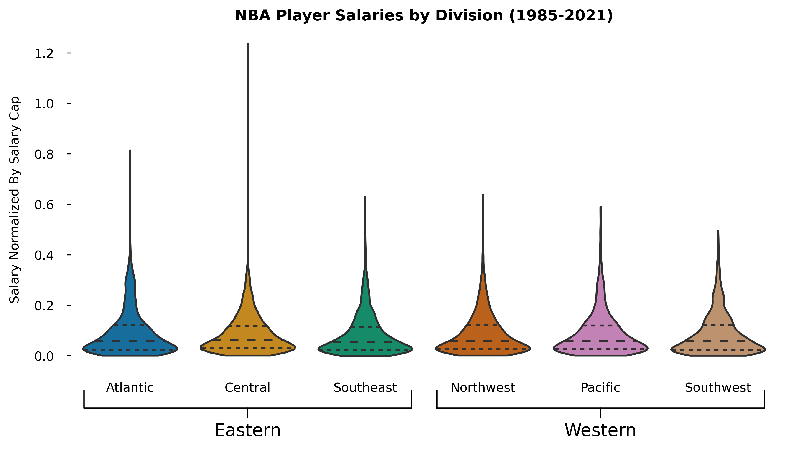
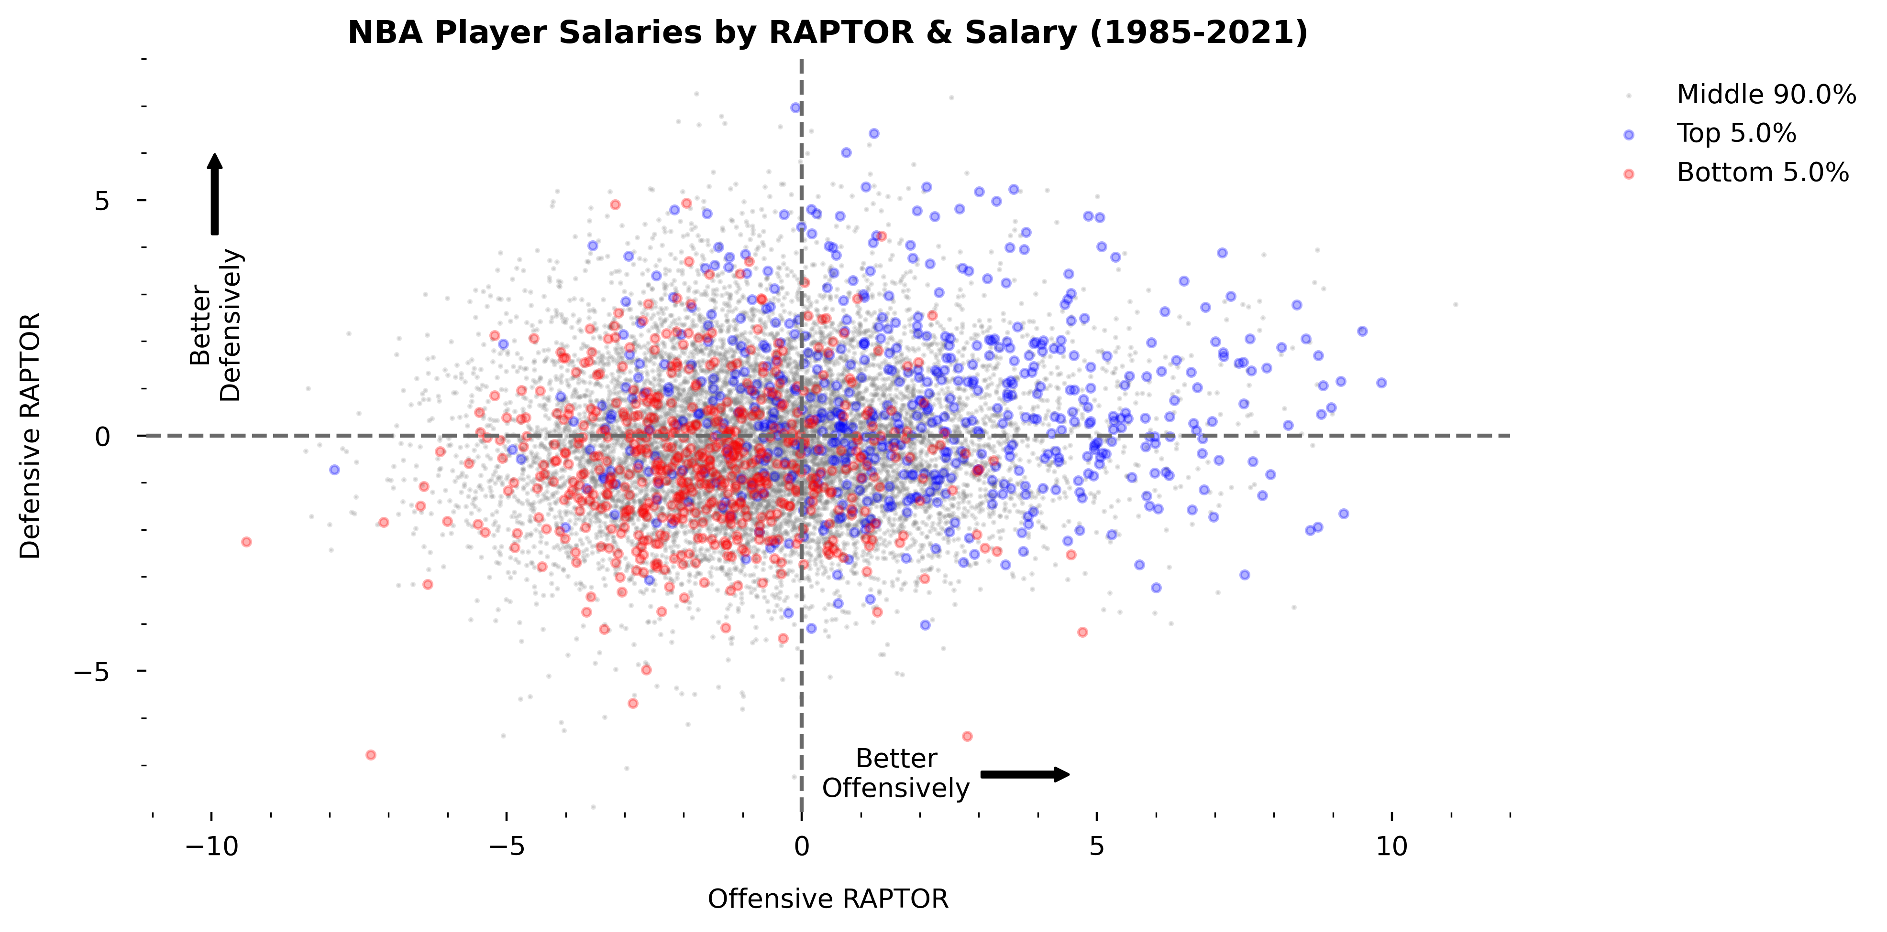
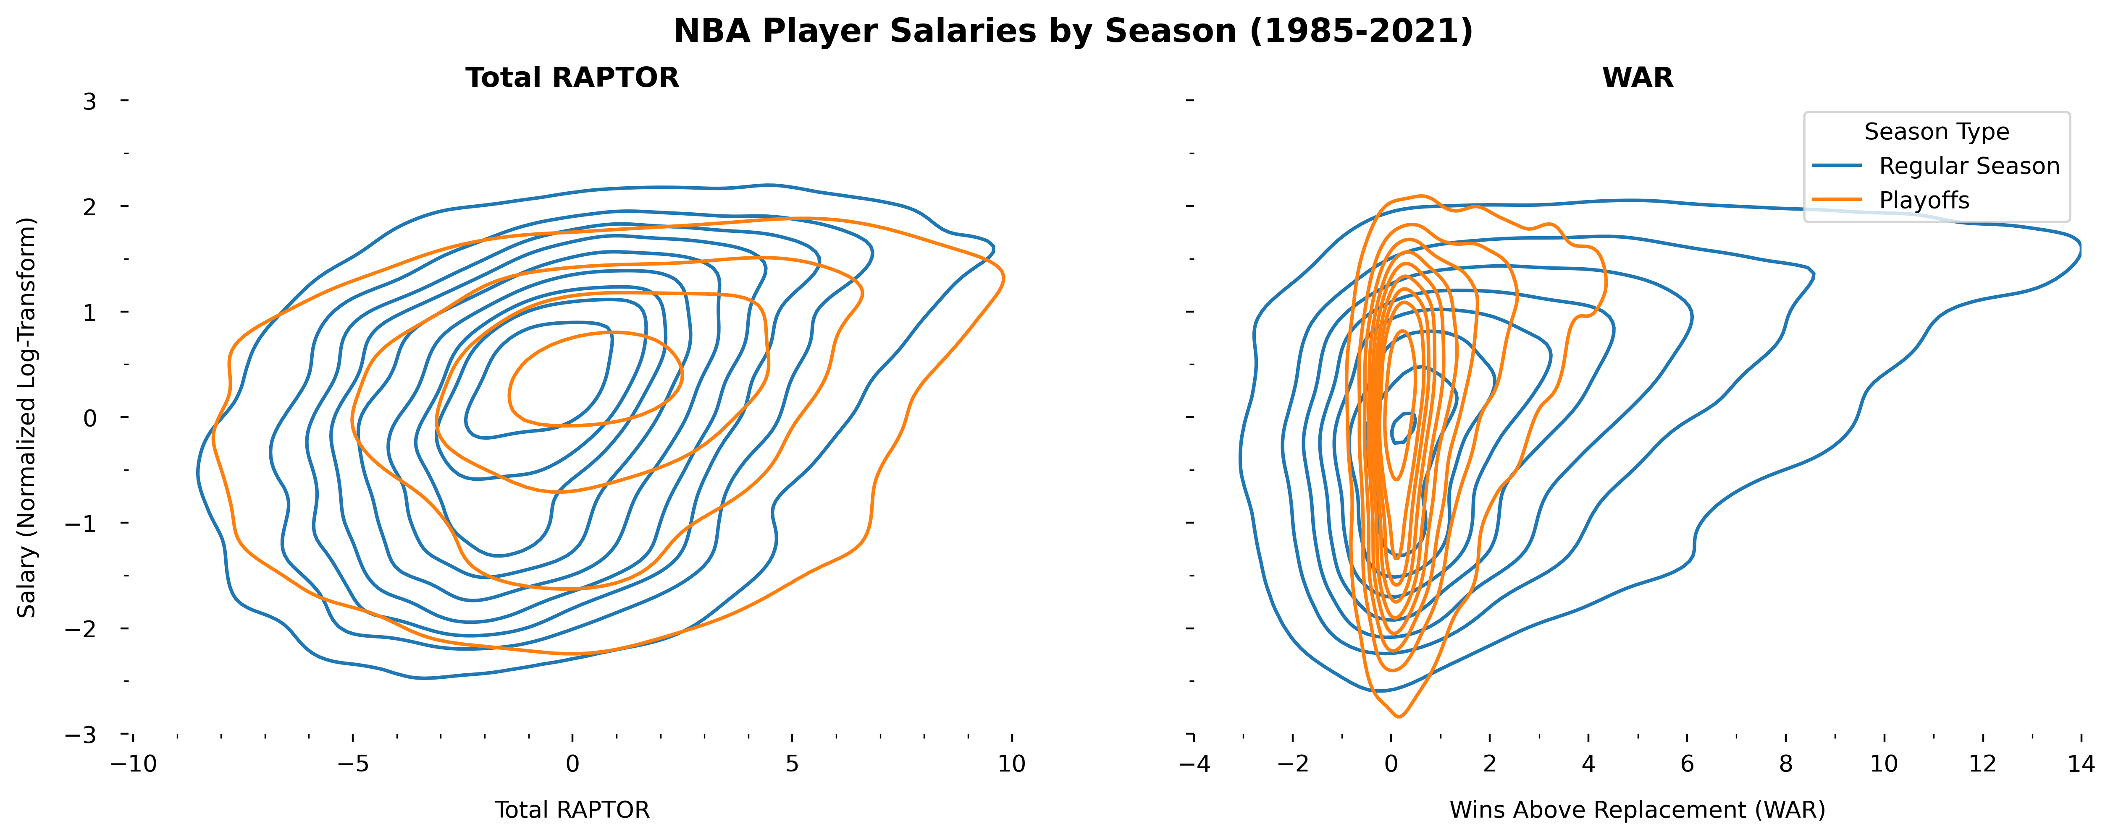


An Exploration of NBA Player Performance & Salary
Yashwanth Manne
CMSE 402 | Michigan State University
Overview
Player Values By Team
Regular Season RAPTOR
This project tracks patterns between NBA player performance and a player’s salary to see if any specific team is generally better at evaluating player talent and if any single player historically outperforms their contract.
Methodology
RAPTOR: The RAPTOR is a novel, aggregative metric on how good a player is based on traditional box-score metrics as well as advanced play-by-play components and “on-off” which evaluates how much better a team when the player is present. There are specific metrics for offense, defense, and total. These metrics are normally distributed and is more stable than WAR (shown right).
WAR: Win shares above replacement. It was the previous traditional metric for measuring player value.
Salary: Salaries were extracted from player’s Basketball-Reference pages. These salaries were scaled by dividing by the league’s salary cap in that season. The salary cap is the max amount of salary any given team is allow to spend on players’ salaries. Salaries followed a lognormal distribution. As such, it was necessary to take the log and calculate z-score of the resulting normal distribution to allow for relative comparisons between player salaries.
PLAYER VALUE: The Z-score of the normalized salary is subtracted from the Z-score of the total RAPTOR metric to identify how much better a player is w.r.t their salary.
These plots show how the offensive and defensive rating of a player correlate with minutes played and the salary of a player.
In the first plot, we see that players with better offensive and defensive ratings tend to play more minutes.
This is expected since it indicates coaches tend to play better players more.
In the second plot, we see that players who perform better tend to have higher salaries.
This is expected since it indicates general managers know what they are doing.
The above plot shows how each team’s average player value by salary evolves over time.
Best Metric to Evaluate Talent
References
https://github.com/fivethirtyeight/data/tree/master/nba-raptor
https://www.basketball-reference.com/

